Slide 1
Device Subsystems

Slide 2
Magnetic Disk
A disk is a circular platter constructed of a non-magnetic material called the substrate (aluminum), coated with a magnetizable material (iron oxide…rust)
Now glass
—Improved surface uniformity
– Increases reliability
—Reduction in surface defects
– Reduced read/write errors
—greater ability to withstand shock and damage
—Better stiffness
—Better shock/damage resistance

Slide 3
Read and write mechanisms
Recording and retrieval via conductive coil called a head
• May be single read/write head or separate ones
• During read/write, head is stationary, platter rotates
• Write
— Current through coil produces magnetic field
— Pulses sent to head
— Magnetic pattern recorded on surface below
• Read (traditional)
— Magnetic field moving relative to coil produces current
— Coil is the same for read and write

Slide 4
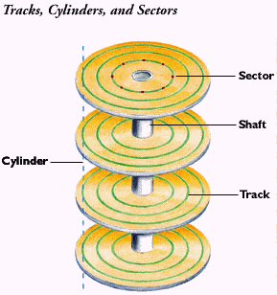
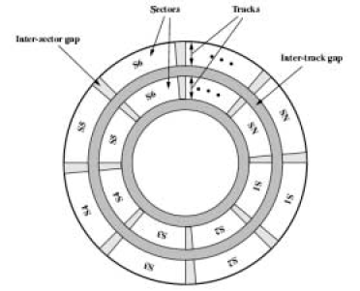
Data organization
Tracks: Hard Disk platters arrange data into concentric circles. Each circle is called a Track.- thousands of tracks per surface
Sectors: The smallest addressable unit on a Track. Sectors are normally 512 bytes in size, and there can be hundreds of sectors per track. They may be of fixed or variable length.
Heads: The devices used to write and read data on each platter.
Cylinders: Platters on a hard disk are stacked up, and so are the heads. Concentric circles from each parallel platter form a cylinder.
Inter track gap: space between tracks to reduce errors due to misalignment of the head or interference of magnetic fields.
Intra track gap: gap between sectors to avoid unreasonable precision requirements on the system (inter sector gap)

Slide 5
Constant angular velocity (CAV)
There is a variation in speed of reading a bit near the center of a disk and a bit on the outside. This can be avoided by increasing the space between bits of information recorded in segments of the disk.
This info can be scanned at the same rate by rotating the disk at a fixed speed (CAV)
Advantage:
  individual blocks of data can be directly addressed by track of sector.
  The head can be moved to a specific address faster
Disadvantage: the amount of data that can be stored on the long outer tracks is the same as on the short inner tracks.=> density is reduced

Slide 6
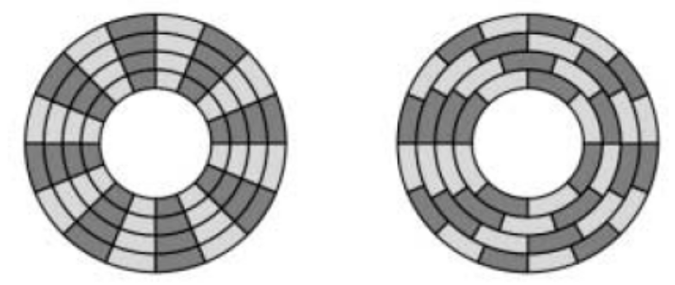
Multiple zone recording
To increase density => multiple zone recording – surface is divided into number of zones.
Zone – number of bits/track is constant
Zones far from the center contain more bits than zones closer to the center
Storage capacity increases with complex circuitry.
CAV Multiple Zone recording

Slide 7
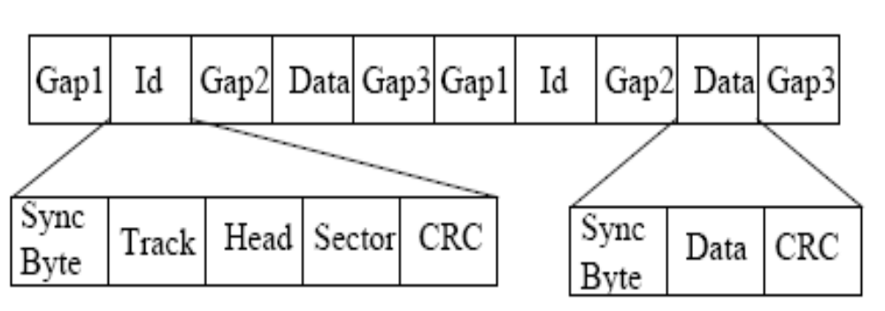
Disk Track Format
ID – to locate a particular sector
Synch – delimits the beginning of the field
Track – identifies a track on the surface
Head – identifies a head
ID and data fields have error detecting codes (CRC)

Slide 8
characteristics
Head motion
  Fixed: one read/write head per track (rare)
  Movable: only one read – write head per surface
Disk portability
  Removable: can be removed and replaced with the other
  Non-removable: permanently mounted in the disk drive (ex: hard disk)
Sides:
  Single sided: magnetizable coating applied on one side
  Double sided: (usually) two sides coated
Platters:
  Multiple platters: disk drives accommodate multiple platters vertically a fraction of an inch apart
  Single platter
Head mechanism
  Contact (floppy): head comes into contact during the operation
  Fixed gap
  Flying (winchester)

Slide 9
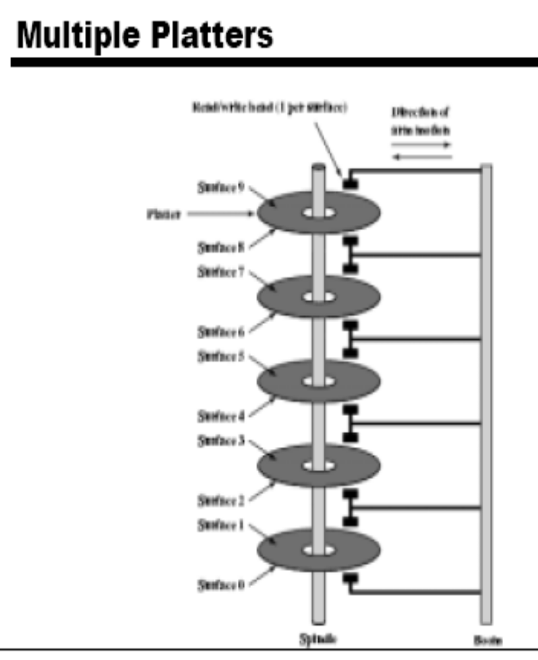
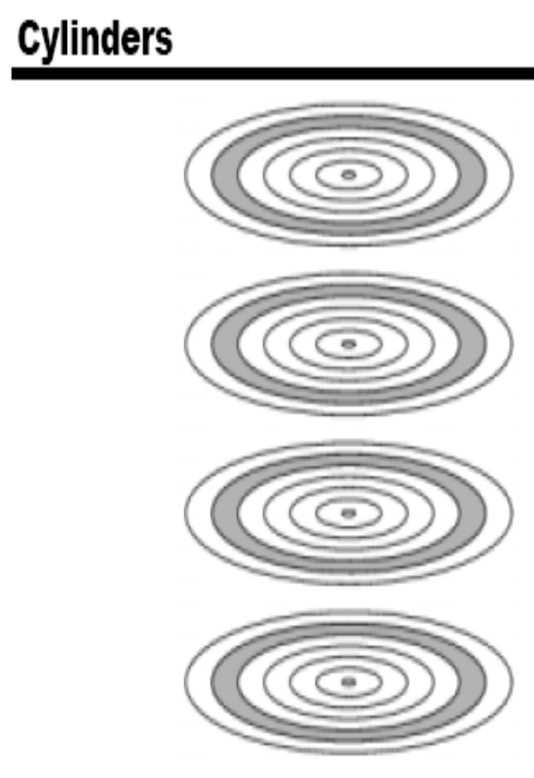

Slide 10
Disk performance parameters
Seek time: on a movable head, time it takes to position the head at the track
Rotational delay/latency: the time it takes for the beginning of the sector to reach the head
Access time: seek time + latency
  Time it takes to get into position to read or write
Transfer time: time required to transfer data
T = b/r*N, where b is the number of bytes to be transferred, r is the rotation speed and N is the number of bytes on a track
Average access time T_{a} = T_{s} + 1/2r + b/rN, where T_{s} is average seek time

Slide 11
RAID (redundant array of independent disks)
Redundant array of inexpensive disks
Multiple disk database design
Not a hierarchy
7 levels (6 levels in common use)
Set of physical disk drives viewed by the OS as a single logical drive
Data are distributed across the physical drives of an array
Redundant disk capacity is used to store parity information => data recoverability
Improve access time and improve reliability

Slide 12
RAID Level 0
Not a true member of the RAID family - does not include redundancy to improve performance.
User and system data distributed across all disks in the array in strips.
Imagine a large logical disk containing ALL data. This is divided into strips (physical blocks or sectors) that are mapped ‘round robin’ to the strips in the array.
A set of logically consecutive strips that maps exactly one strip to each array member is referred to as a stripe.
+ If two different I/O requests are pending for two different
blocks of data – then there is a good chance that the data will be
on different disks and can be serviced in parallel.
+ If a single I/O request is for multiple logically continuous
strips – up to n strips can be handled in parallel.

Slide 13
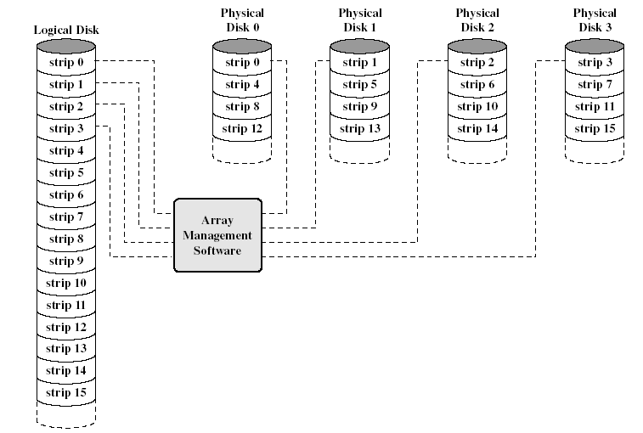
Data Mapping for RAID Level 0
This software may execute either in the disk sub system or in a host computer

Slide 14
RAID Level 1
Redundancy achieved through duplicating all data.
Data stripping is similar to RAID level 0.
Each logic strip is mapped to two physical disks.
  Read request can be serviced from either of available 2 disks, which ever involves the minimum seek time and rotational latency
  Write request requires both disks to be updated – but this can be done in parallel. (Slower write dictates overall speed).
  Recover from failure is simple! (data may still be accessed from the second drive
Disadvantage:
  Cost
    requires twice the disk space
    Configuration is limited, so used only for system software and other highly critical files.
Improvement occurs if the application can split each read request so that both disk members participate

Slide 15
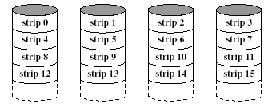
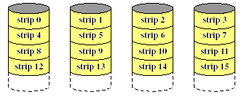
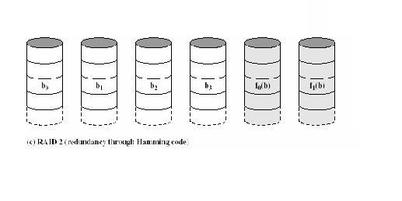
RAID Level 1 (Mirroring

Slide 16
RAID Level 2
Utilizes parallel access techniques - All disks participate in the execution of every I/O request.
Spindles of individual drives are synchronized so that each disk head is in the same position on each disk at any given time.
Data striping – very small strips (single byte or word).
Error correcting code is calculated across corresponding bits on each disk, and the code bits are stored in corresponding bit positions on multiple parity disks.
For Hamming Code – number of parity (redundant) disks is proportionate to the log of the number of data disks.
On a single read, all disks are simultaneously accessed. The requested data and the associated error correcting code are delivered to the array controller. Array controller can detect and fix single bit errors.
For write – all disks must be accessed.
Good choice – only for an environment in which many errors occur – therefore not used much (given high reliability if individual disks and disk drives).

Slide 17
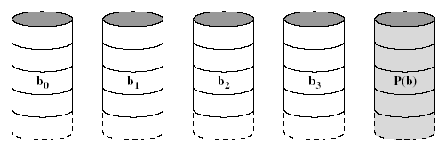
RAID Level 3(bit interleaved parity)
Similar to RAID 2 – parallel access with data distributed in small strips.
Requires only a single redundant disk because it uses a single parity bit for the set of individual bits in the same position on all of the data disks.
If drives X0-X3 contain data, and X4 contains parity bits.
X4(i) = X3(i) ⊕ X2(i) ⊕ X1(i) ⊕ X0(i)
Redundancy – in the case of disk failure, the data can be reconstructed.
If drive X1 fails – it can be reconstructed as:
X1(i) = X4(i) ⊕ X3(i) ⊕ X2(i) ⊕ X0(i)
Performance – can achieve high transfer rates, but only one I/O request can be executed at one time. (Better for large data transfers in non transaction-oriented environments).

Slide 18
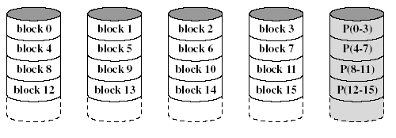
RAID Level 4( block level parity
)
Each disk operates independently - Separate I/O requests satisfied in parallel.
Suitable for applications with high I/O request rates and NOT well suited for those requiring high data transfer rates.
Data striping. (Strips are larger than in lower RAIDs).
Bit-by-bit parity strip is calculated across corresponding strips on each data disk, and stored in corresponding strip on the parity disk.
Performance – write penalty when I/O request is small size. Write must update user data + corresponding parity bits.
X4(i) = X3(i) ⊕ X2(i) ⊕ X1(i) ⊕ X0(i)
If X1(i) is changed to X1’(i)
X4’(i) = X3(i) ⊕ X2(i) ⊕ X1’(i) ⊕ X0(i)
To calculate new parity, the old user data,new user data and old parity strips must be read. Then it can update these two strips with the new data and the newly calculated parity. Thus each strip write involves two reads and two writes.

Slide 19
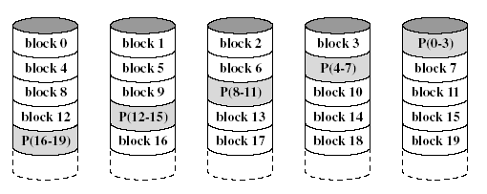
RAID Level 5( block distributed parity)
Same as RAID 4 – but parity strips are distributed across all disks.
Typical allocation uses round-robin.
For an n-disk array, the parity strip is on a different disk for the first n strips and the pattern then repeats.
Avoids potential bottleneck found in RAID 4.

Slide 20
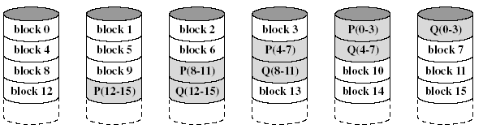
RAID Level 6(dual redundancy)
Two different parity calculations are carried out and stored in separate blocks on different disks.
  Example: XOR and an independent data check algorithm => makes it possible to regenerate data even if two disks containing user data fail.
No. of disks required = N + 2 (where N = number of disks required for data).
Provides HIGH data availability.
Incurs substantial write penalty as each write affects two parity blocks.

Slide 21
Comparison of RAID Levels
Category | Level | Description | I/O request rate (Read/Write) | Data Transfer Rate (Read/Write) | Typical application
Stripping | 0 | Nonredundant | large strips: excellent | small strips: excellent | applications requiring high performance for non-critical data
Mirroring | 1 | Mirrored | Good/Fair | Fair/fair | System drives; critical files
Parallel access | 2 | redundant via hamming code | poor | excellent
 | 3 | Bit-Interleaved parity | poor | excellent | large I/O request size applications, such as imaging, CAD
independent access | 4 | Block-interleaved parity | excellent/fair | fair/poor
 | 5 | Block-interleaved distributed parity | excellent/fair | fair/poor | high request rate, read intensive, data lookup
 | 6 | block-interleaved dual distributed parity | excellent/poor | fair/poor | applications requiring extreamly high availability

Slide 22
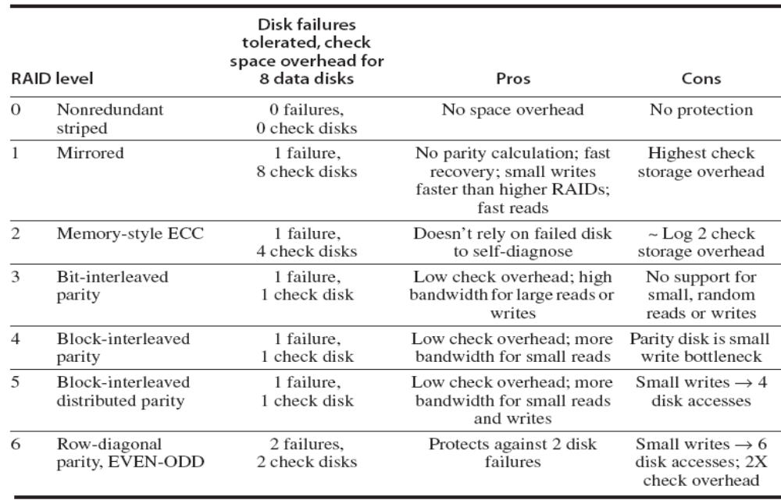
Comparison of RAID Levels

Slide 23
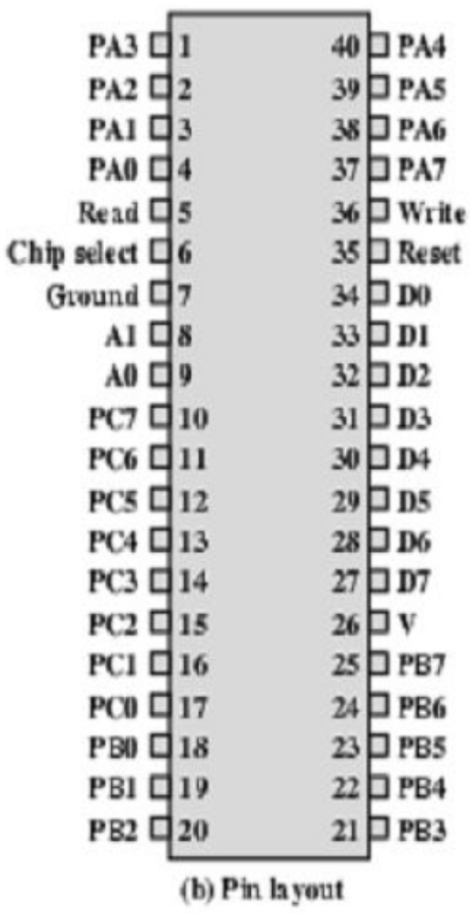
I/O Controllers for keyboard
Intel 82C55A Programmable Peripheral Interface is a simple I/O controller used to handle the keyboard and the internal speaker
• The PPI has 24 I/O lines designated as 8-bit registers or ports A, B, and C
—C is nibble-addressable and can be used to control A and B
—Another 8 bit register is the control register
• There are 8 bidirectional data lines
• Two address lines are used to select A,B,C or Control
• A transfer takes place when Chip Select is enabled along with Read or Write line

Slide 24
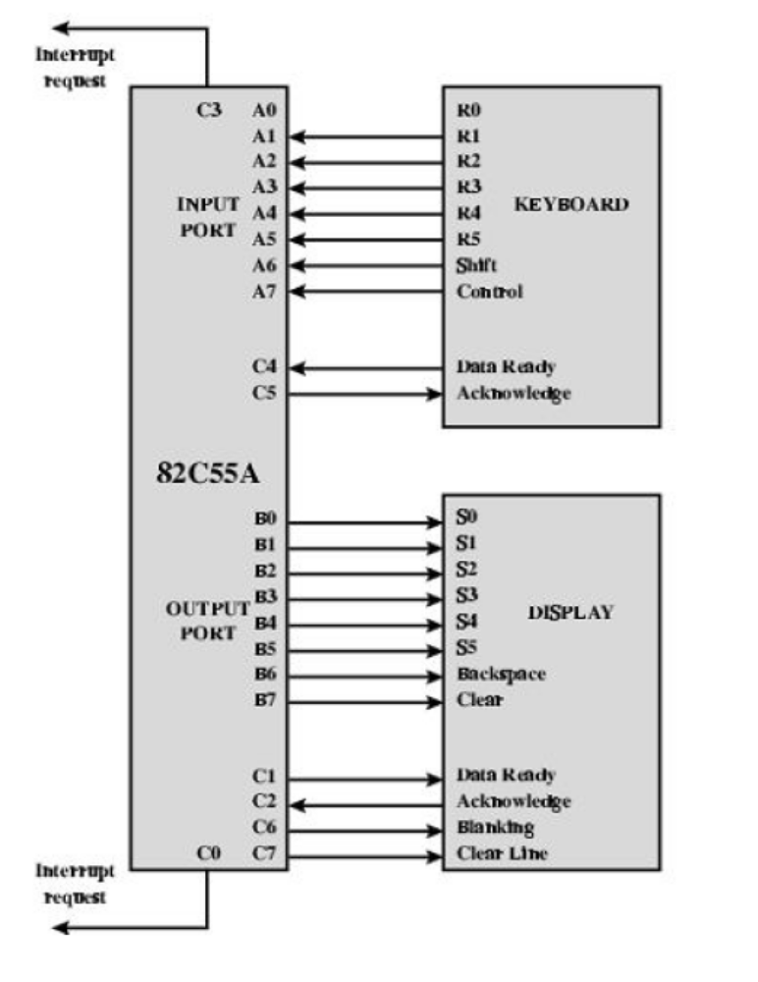
The keyboard provides 8 bits of input. Two of these bits, shift and control, have special meaning to the keyboard handling program executing in the processor.
This is transparent to 82C55A, which simply accepts the 8 bits of data and presents them on the system data bus.
two handshaking control lines are provided for use with the keyboard

Slide 25
Controller for a Mouse
The UT84520 Scrolling Mouse Controller is specially designed to control PS/2 mouse device．

